Slide 1


JAVA PROJECT MILK TEA SHOP MILK TEA SHOP MANAGEMENT SYSTEM
Instructor:
Teacher. Luong The Anh
Group 3:
Dao Minh Trung Thuan
Ha Thi Hong Tham
Tan Tan Lap

Slide 2
MILK TEA SHOP MANAGEMENT SYSTEM
PURPOSE OF THE TOPIC
PROGRAM OVERVIEW
SYSTEM BUILDING PROCESS

Slide 3
PURPOSE OF THE TOPIC
Store management system:
Customers can order bill simpler
Employees don’t work too much.
Manager can manage bills, employees, status and income of shop.

Slide 4
PROGRAM OVERVIEW
Score:
Basic manage milk tea shop.
Statistic bill.
Calculate revenue.
Export report bill.
Order food.
Pay bill.

Slide 5
PROGRAM OVERVIEW
Customer:
Can order food, choose table and pay bill.
Can register, log into system or enter discount code.
Employee:
Log in to use system.
Can manage order bills in food tables, status of food tables, and food
Manager:
Can manage bills, employees, accounts and income of shop.

Slide 6
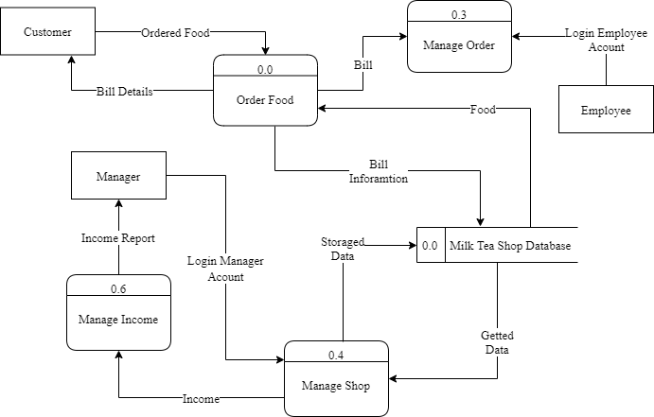
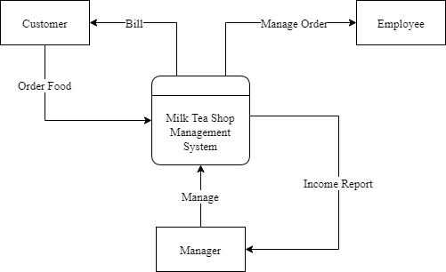
SYSTEM BUILDING PROCESS
Design system:
Context level data flow diagram
Level 0 data flow diagram

Slide 7
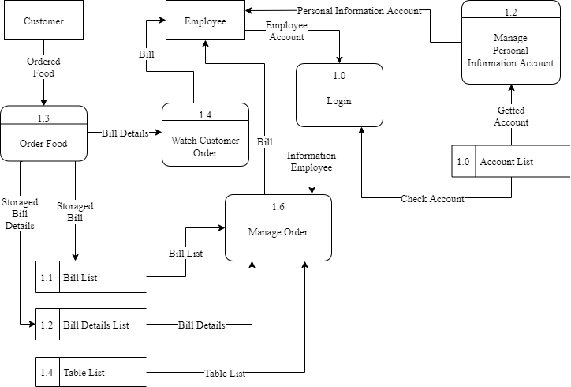
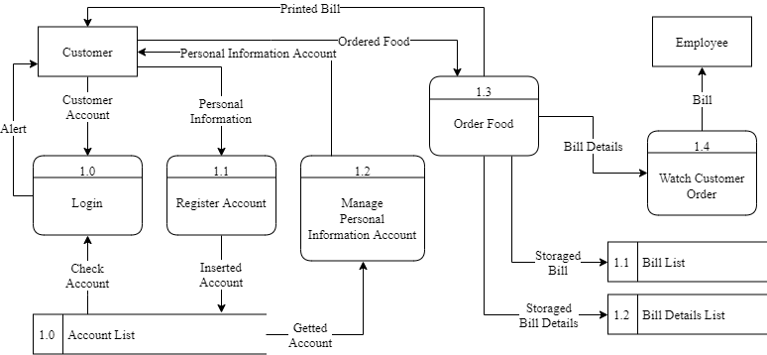
SYSTEM BUILDING PROCESS
Design system:
Level 1 data flow diagram for customer
Level 1 data flow diagram for employee

Slide 8
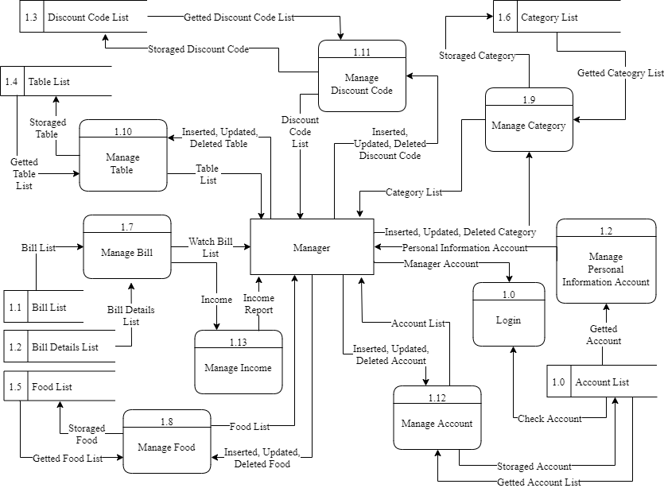
SYSTEM BUILDING PROCESS
Design system:
Level 1 data flow diagram for manager

Slide 9
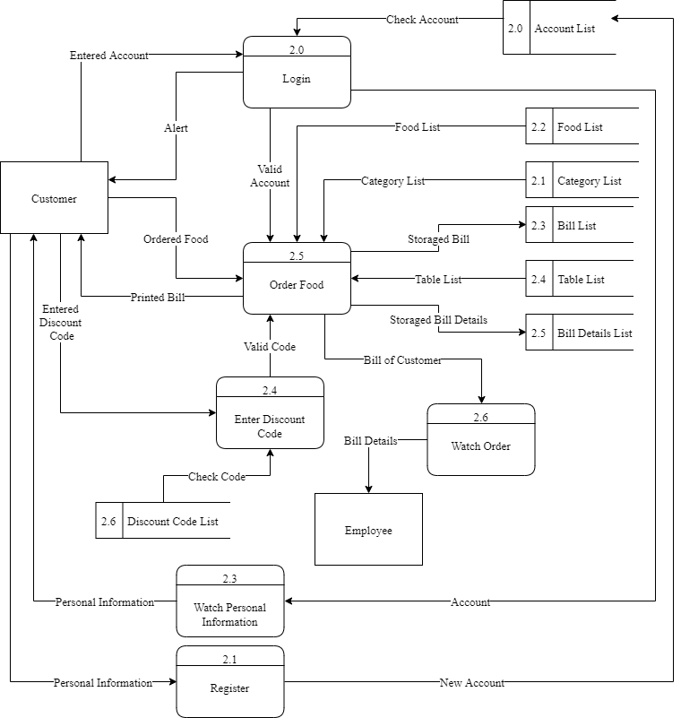
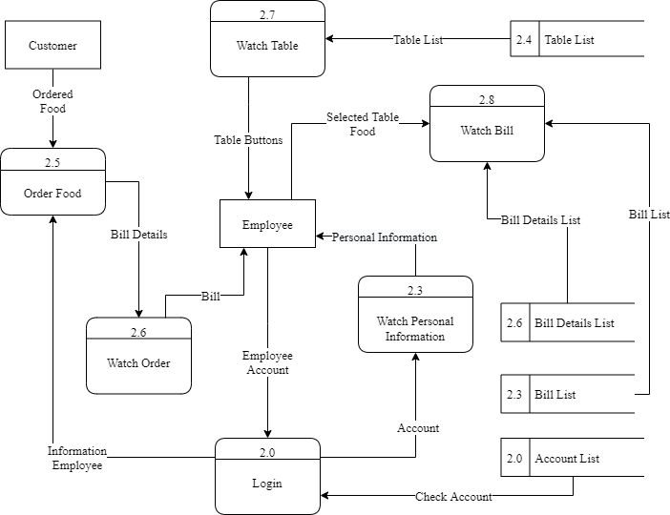
SYSTEM BUILDING PROCESS
Design system:
Level 2 data flow diagram for employee
Level 2 data flow diagram for customer

Slide 10
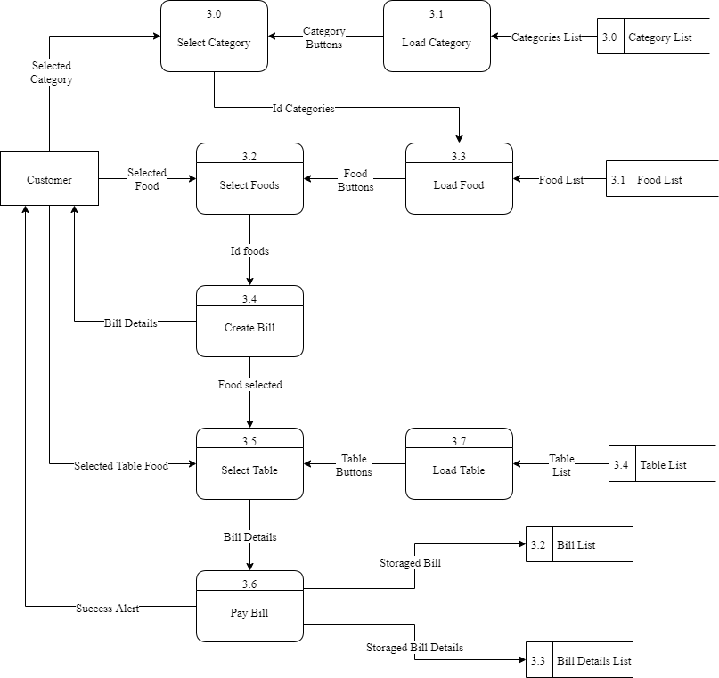
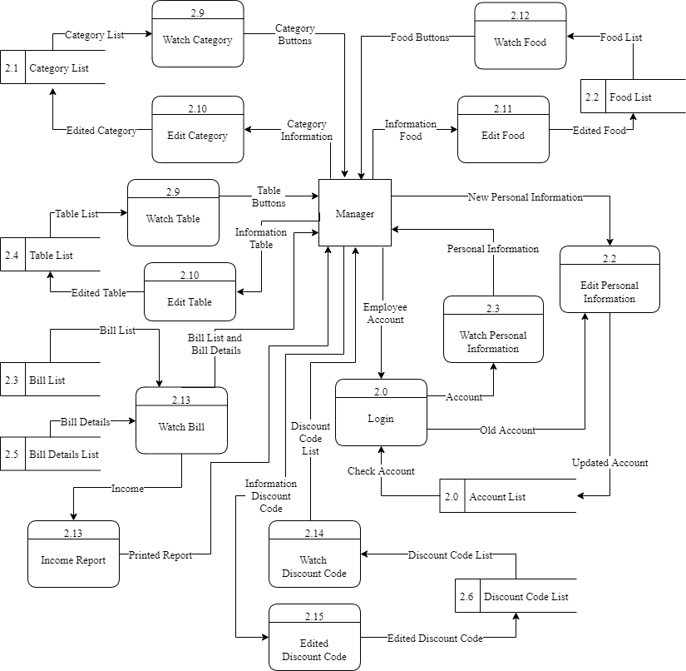
SYSTEM BUILDING PROCESS
Design system:
Level 2 data flow diagram for manager
Level 3 data flow diagram for Order food process

Slide 11
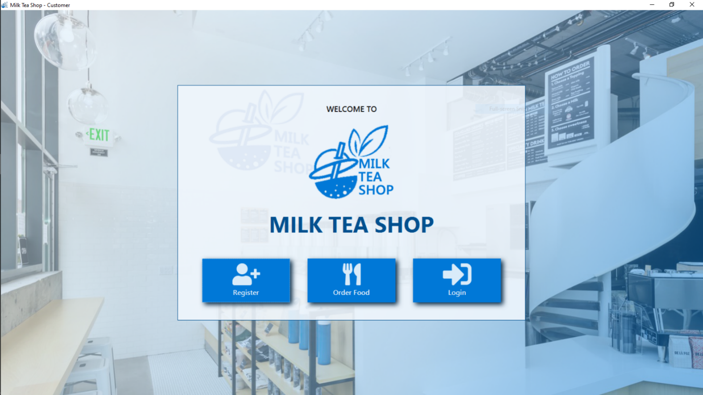
SYSTEM BUILDING PROCESS
Design interface:
Welcome customer form

Slide 12
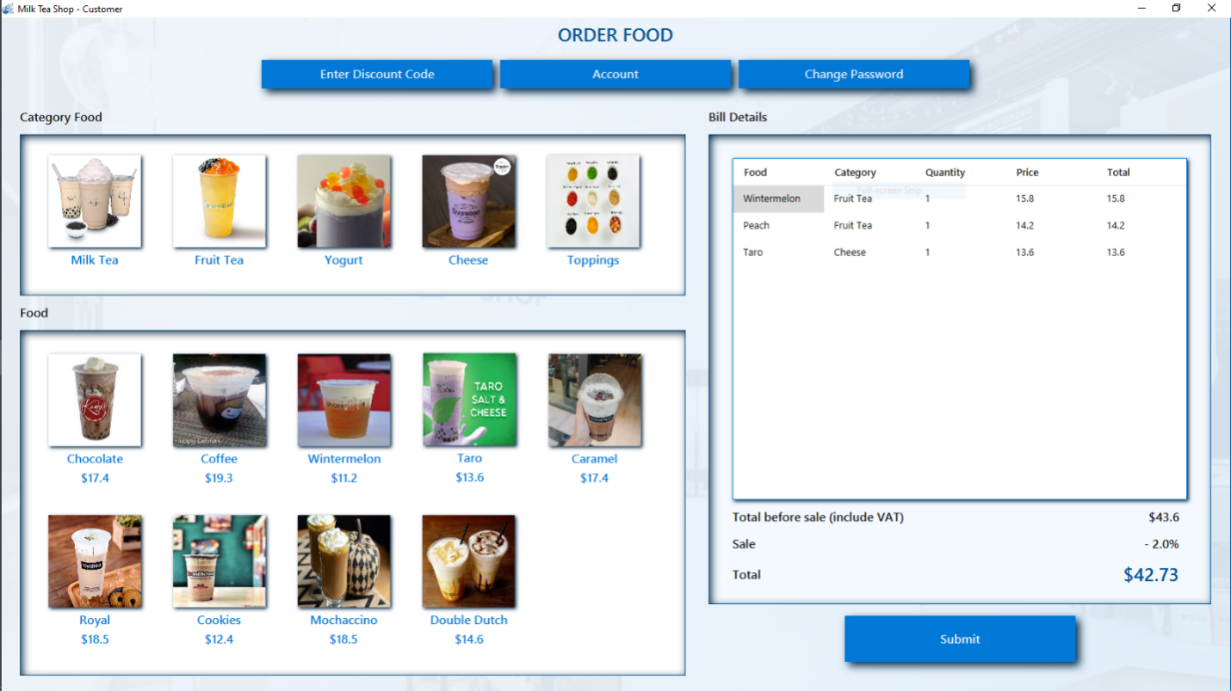
SYSTEM BUILDING PROCESS
Design interface:
Order food form

Slide 13
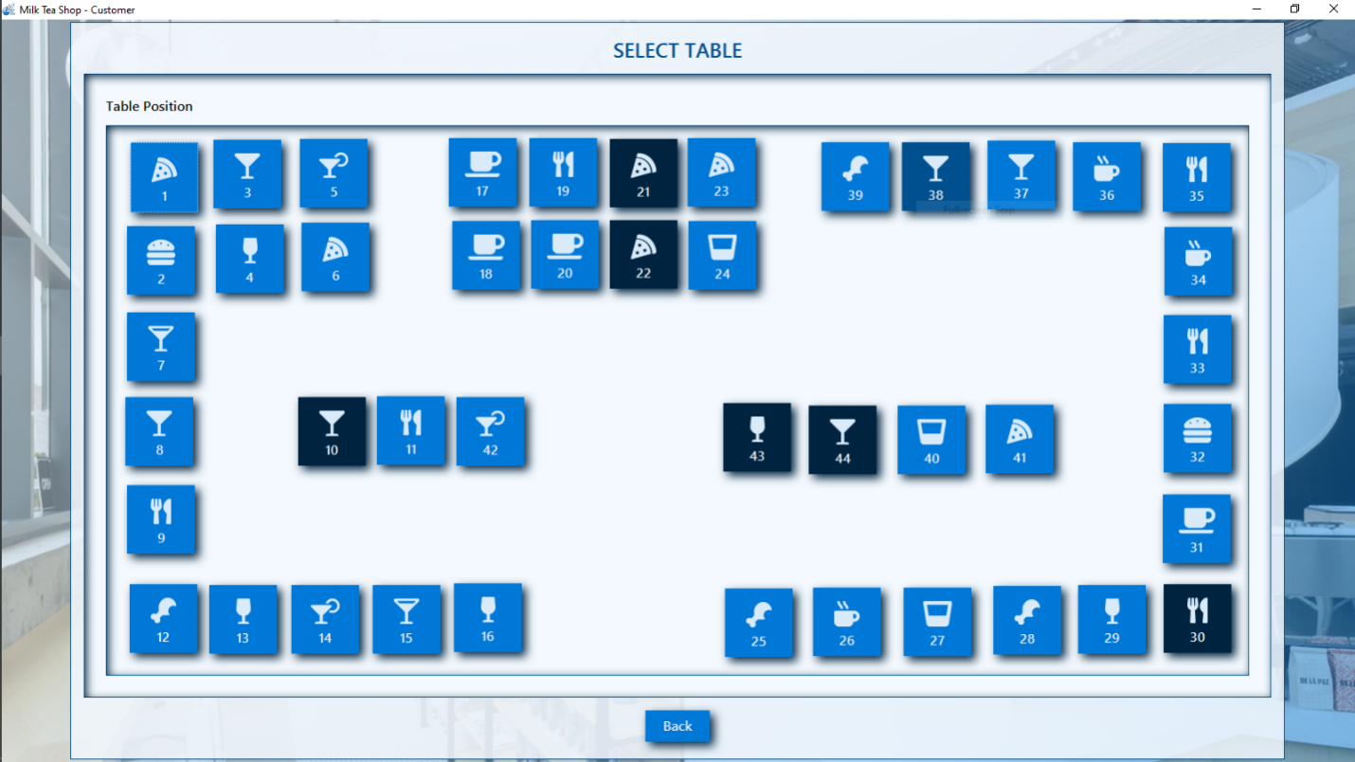
SYSTEM BUILDING PROCESS
Design interface:
Choose table form

Slide 14
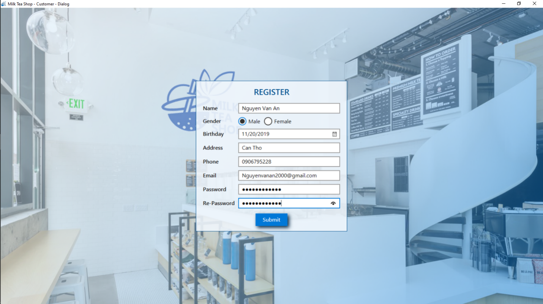
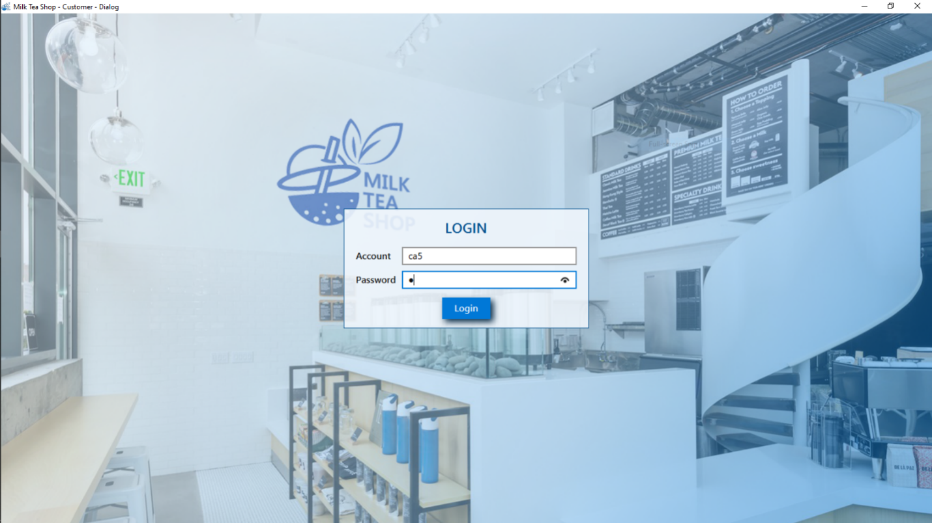
SYSTEM BUILDING PROCESS
Design interface:
Register form
Login form

Slide 15
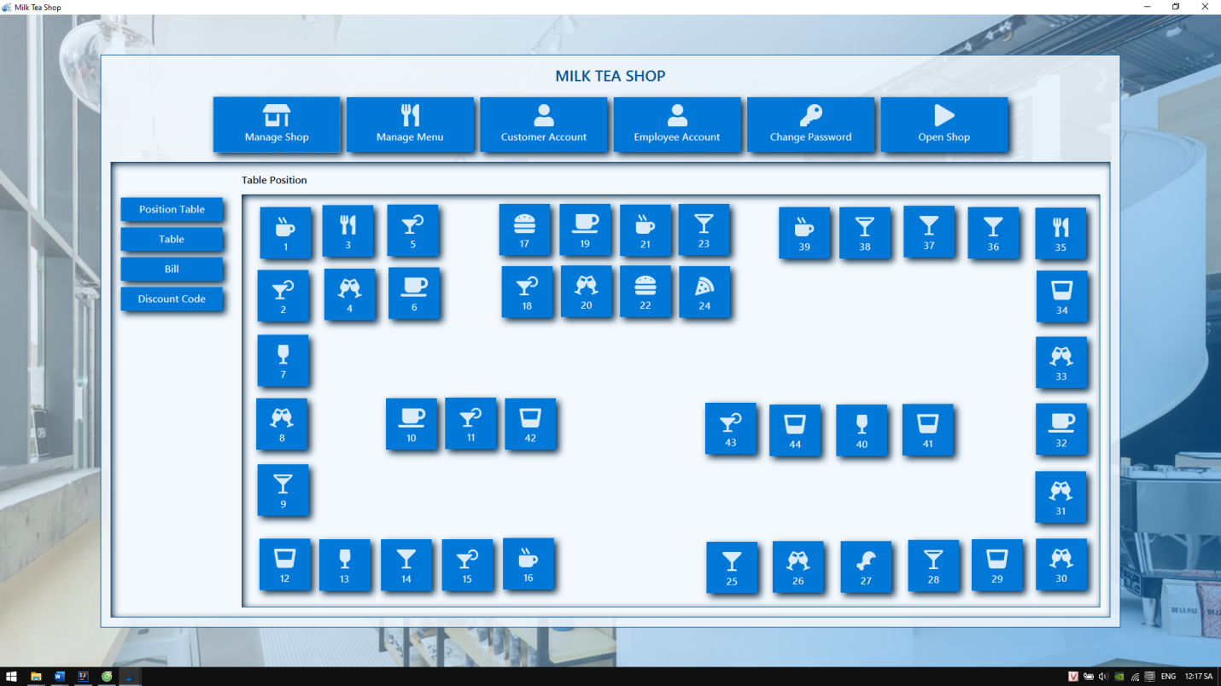
SYSTEM BUILDING PROCESS
Design interface:
Employee form

Slide 16
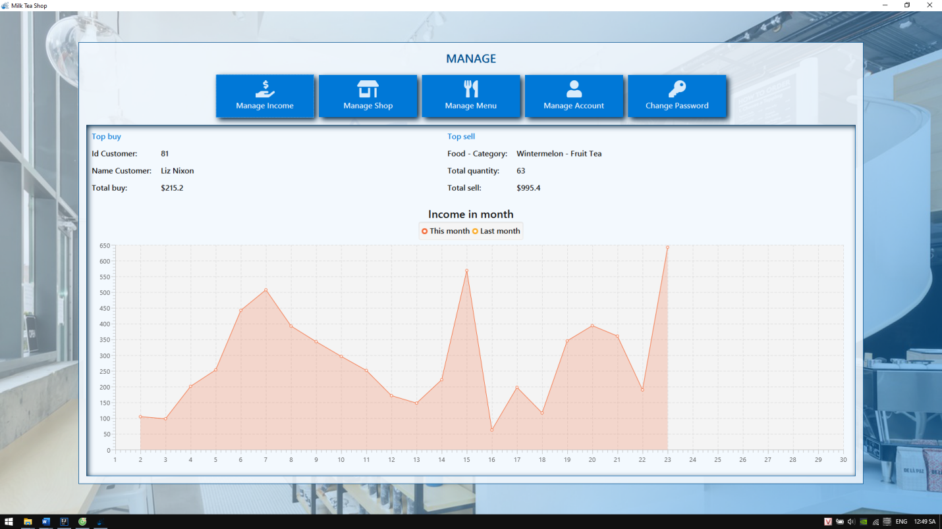
SYSTEM BUILDING PROCESS
Design interface:
Manage income form

Slide 17
THANKS FOR YOUR WATCHING

